Slide 1
Class Meetings
Building a Positive Classroom Culture
Ashley Smith
ashley.smith@cms.k12.nc.us

Slide 2
“Your attitude and behavior will determine how much and what kind of respect a person will have for you” Rashida Rowe
Notes:
Turn and talk about how this quote is relevant to your experiences as a teacher/student/human being

Slide 3
Wait…Stop…Why???
160,000 children miss school everyday due to fear of attack or intimidation by other students. (NEA)
Every seven minutes a student is bullied at school. (Dan Olweus)
One out of twenty students has seen a student with a gun at school. (NYVPRC)
Suicide was the third leading cause of death for young people 10 to 19 years old in 2000. (NYVPRC)
Notes:
Discuss the importance of making children feel safe and helping them become caring, empathetic productive citizens

Slide 4
How do can we help?
Build Emotional Intelligence
Increase student Empathy
Open environment vs. Closed doors
Lasting relationships built upon trust
HAVE CLASS MEETINGS!

Slide 5
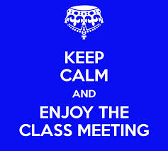
Notes:
Video
Talk about what they noticed in the video. What stuck with them?

Slide 6
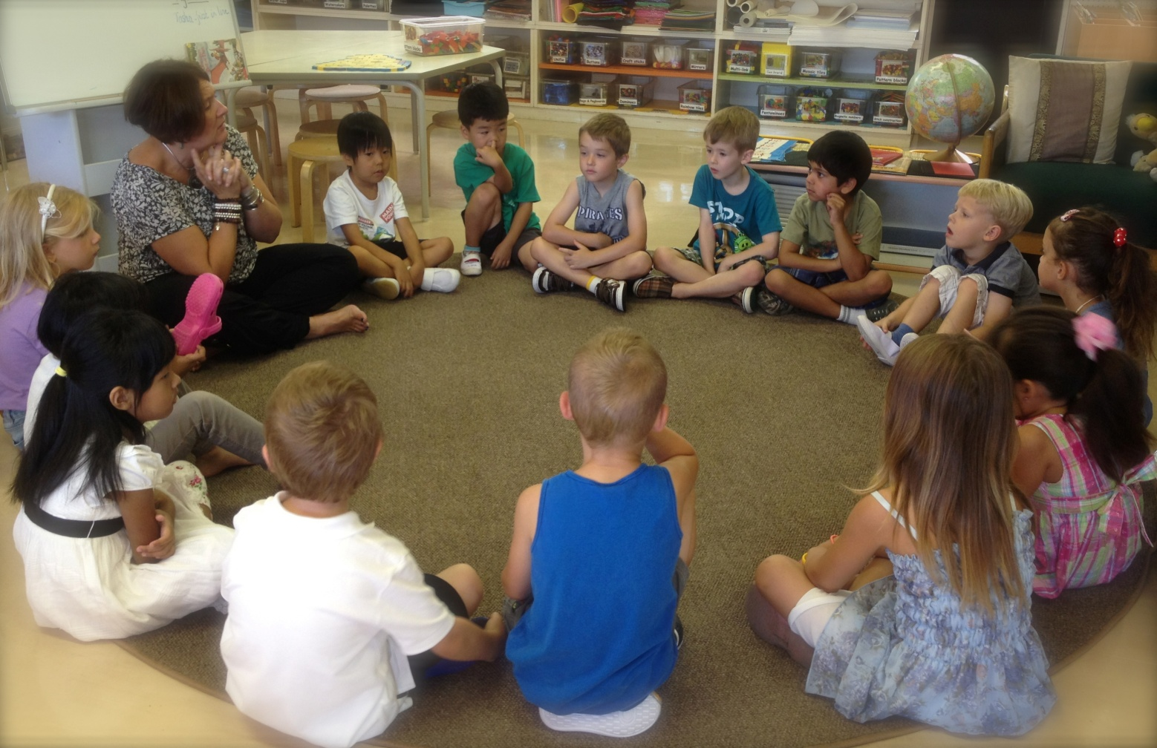
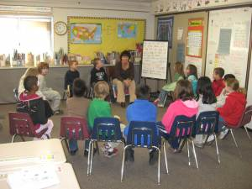
What does it look like?
Notes:
Show how teacher and students are on the same level, there is a circle. It can be floor or chairs.

Slide 7
Circle
Floor or Chairs?
Everyone MUST be at same level
Nothing with them
1 minute or less
Time students
Challenge them

Slide 8
Purposes
Give Compliment
Solve Problems (conflict resolution)
Plan Events

Slide 9
Compliments
I would like to compliment ___ for ___.
Compliments are given for:
Helpfulness
Accomplishments
Sharing
Just say “Thank You!”
Notes:
As a table, practice giving and receiving compliments at your table

Slide 10
Agenda
Someone has been pushing me in line and I have asked them to stop and they won’t. Ashley
What do you say?
“Several people have reported (via the class meeting box) that there has been much pushing in line. How can we solve this?”
A friend has been playing in line and will not stop. Jacob
Notes:
Show what could appear in student notes. Point out that the names are left off except for the person making the request for help. This is NOT a tattle box, this is a request for problem solving box.
Discuss how the teacher would bring up the problem

Slide 11
Solutions
“Where did we ever get the crazy idea that in order to make children DO better first we have to make them FEEL worse?”- Nelson
Notes:
Discuss this quote with your partner

Slide 12
4 R’s of Logical Consequences
Related
Respectful
Reasonable
Revealed
Notes:
Discuss each one and what it means for consequences. Brainstorm a list of consequences for the problem of someone pushing in line.

Slide 13
“Because you believed I was capable of behaving decently, I did.” ― Paulo Coelho,

Slide 14
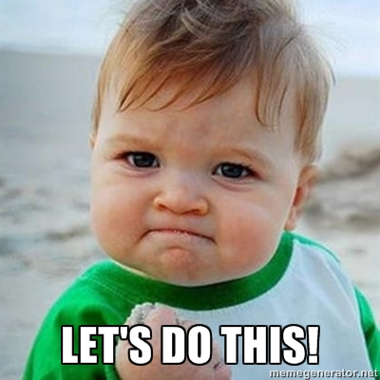
Let’s Practice…
Notes:
Model a class meeting.

Slide 15
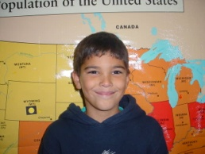
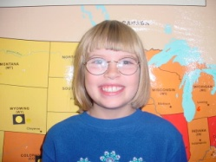
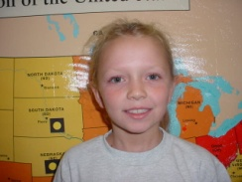
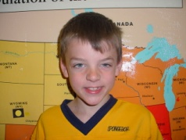
Why do you like having Class Meetings?
“I really like giving people compliments because it makes you feel all tingly inside.”
Brandon, 5th grade
“What I like about class meetings is we get to talk about our problems.”
Katlyn, 5th grade
“I like that we get to talk about stuff happening in our classroom and the changes we can make.”
Emily, 5th grade
“I like having discussions on different things in the classroom and I like to give and get compliments.”
Kathleen, 5th grade

Slide 16
We learn from our mistakes only if we are not afraid to make mistakes! Rudolph Dreikurs

